Slide 1
Syriatel Churn prediction Ingavi Kilavuka

Slide 2
Overview
About Syriatel: Syriatel, founded in 2000, is a major mobile network provider in Syria, offering LTE services known as Super Surf. Initially operating under a BOT contract, it introduced 4G services in 2017 but faced judicial custody in 2020.
Stakeholders:
Customers: Influenced by efforts to reduce churn through improved services and loyalty programs.
Management: Directly impacted by churn's effects on revenue and market position, prompting strategic decisions.
Employees: Job security and growth affected by churn, potentially leading to cost-cutting measures.

Slide 3
Business problem
Customer churn, where subscribers cancel or switch services, impacts revenue and growth. It includes voluntary (customer choice) and involuntary (company-initiated) churn.
Objectives:
Understand churn causes.
Predict churn.
Mitigate churn through strategies.

Slide 4
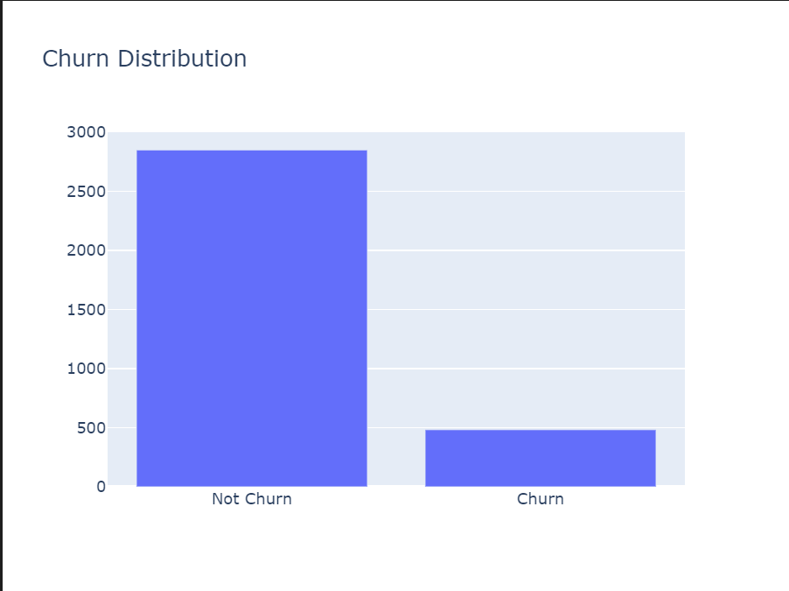
Visualizations - Churn distribution
Higher number of customers that do not churn compared to customers that do churn.

Slide 5
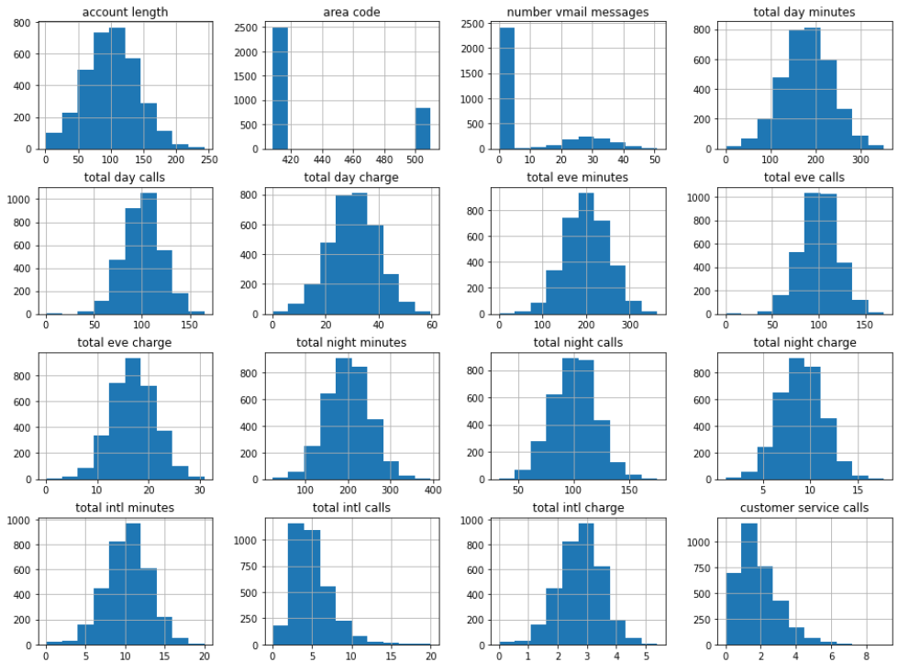
Distribution of each predictor column

Slide 6
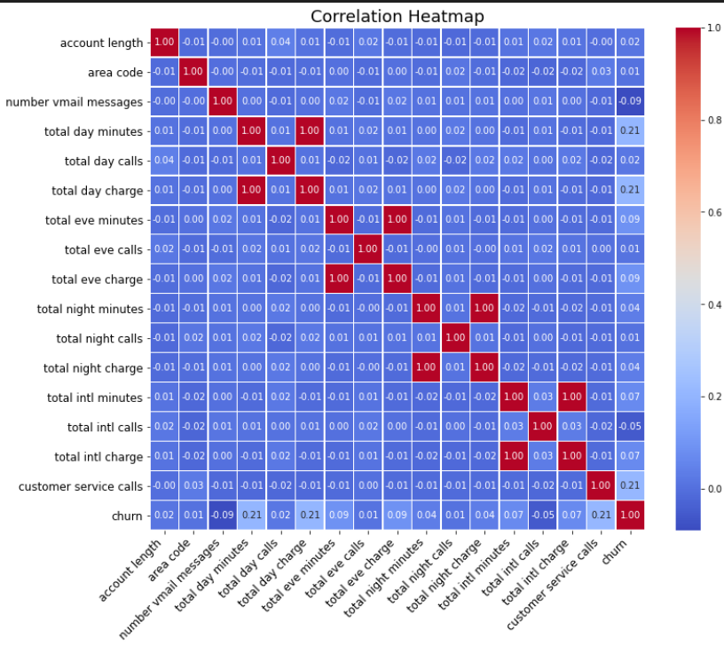
Correlation heatmap

Slide 7
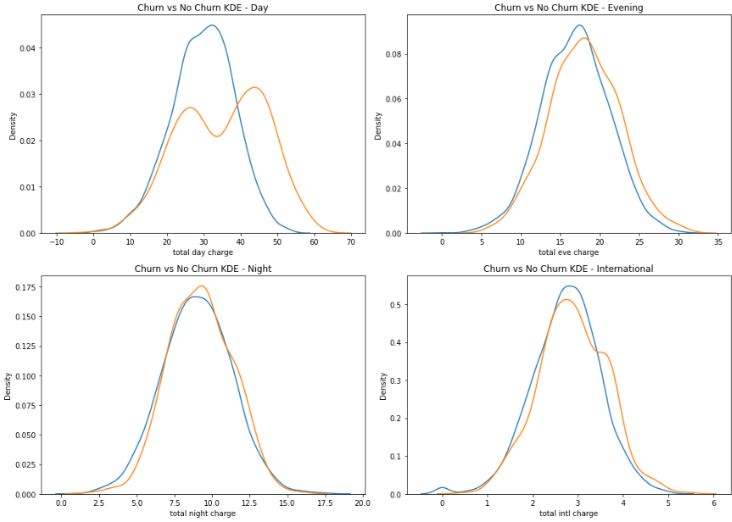
Churn by Charges

Slide 8
Modelling
I used several models to predict customer churn, including Logistic Regression, Decision Tree, and K-Nearest Neighbors. Ultimately, I selected the Decision Tree model because it demonstrated the best performance.
It achieved an accuracy of 89% and an ROC AUC score of 81%, making it a reliable predictor of customer churn. The Decision Tree model effectively identified key factors influencing churn, such as high charges, state-specific behaviors, and international plan usage. The analysis revealed that higher charges were strongly associated with increased churn.

Slide 9
Evaluation
My analysis revealed that higher charges were strongly associated with increased churn. Customers with high usage rates, especially during nights and internationally, showed higher likelihoods of leaving. Additionally, certain states exhibited higher churn rates, indicating regional differences in customer retention.

Slide 10
Recommendation
Consequently, I recommend focusing on reducing charges to lower churn rates. Offering more competitive rates in states with higher churn can help retain customers in those regions. Making international calls more affordable can also reduce the churn rate among customers who frequently make such calls.
Providing dynamic pricing models could cater to customers' varying willingness to spend on calls, ensuring that pricing aligns more closely with customer needs and preferences. Moreover, enhancing customer engagement and service quality, particularly through increased customer service calls, can significantly help in retaining high-usage customers.
Tailored incentives and improved service offerings based on customer feedback are essential strategies to ensure customer satisfaction and loyalty. Additionally, expanding voicemail plan availability, as it has shown a positive impact on reducing churn, and actively engaging with customers to solicit feedback and implement their suggestions can further enhance customer retention.

Slide 11
Thank
you

